Slide 1
UTILISING DEEP LEARNING IN
SIGN LANGUAGE
RECOGNITION & INTERPRETATION
CHAN JOSHUA JUAN YIN | BRANDON LIN ZHAN HONG | DUONG NGOC YEN
PHAM VAN LONG PHUOC | YU XINHUI | WANG YUJING

Slide 2
AGENDA
Preface & Objectives
Product Showcase
Merits & Limitations
Approaches & Outcomes
Future Improvements
Concluding Statements
References
Q&A

Slide 3
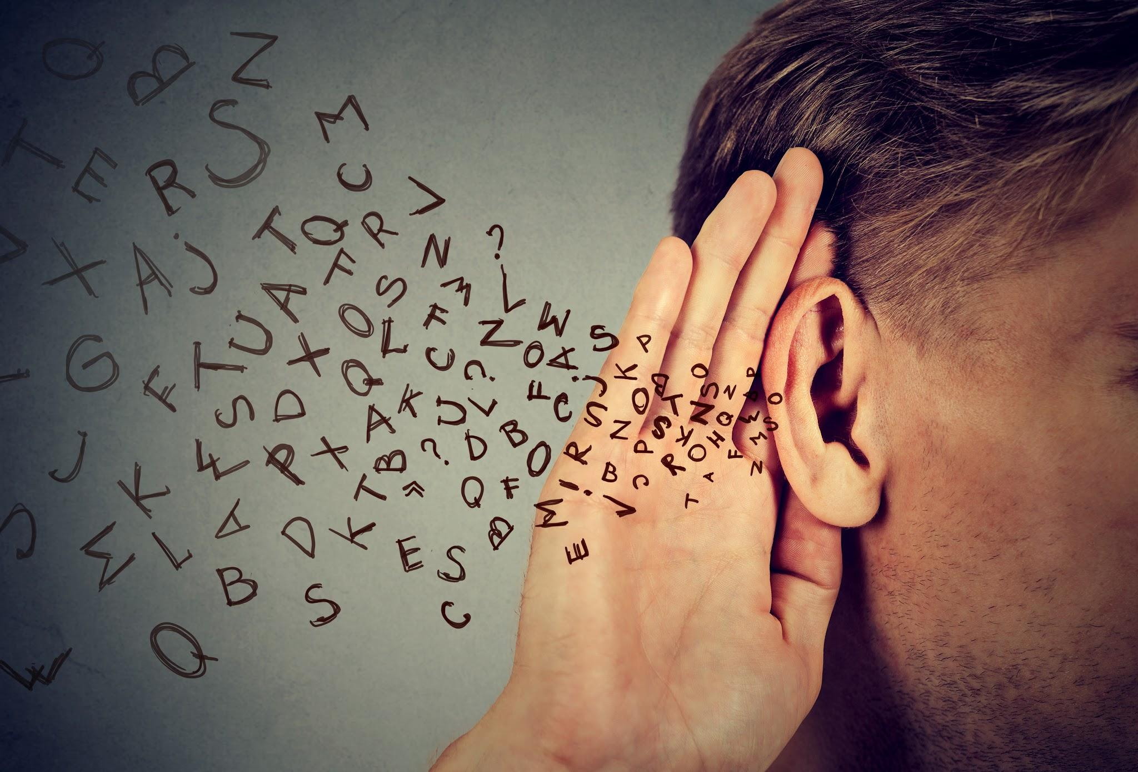


5%
Percentage of Global Population with some form of disabling hearing loss
[1]

Slide 4

Sign Languages
[2]

Slide 5
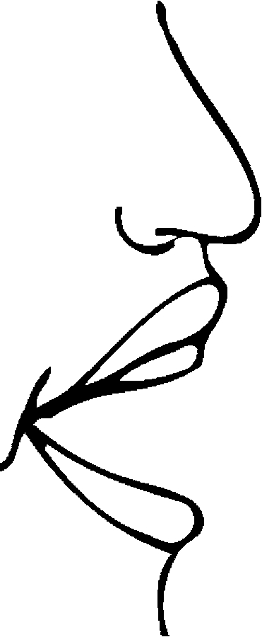
Distinct differences in communication mediums
Enabling effective interaction presents a unique challenge
Conversing difficult without aid of an interpreter or technological accessibility
Lack of communication fosters misunderstanding
[3]

Slide 6
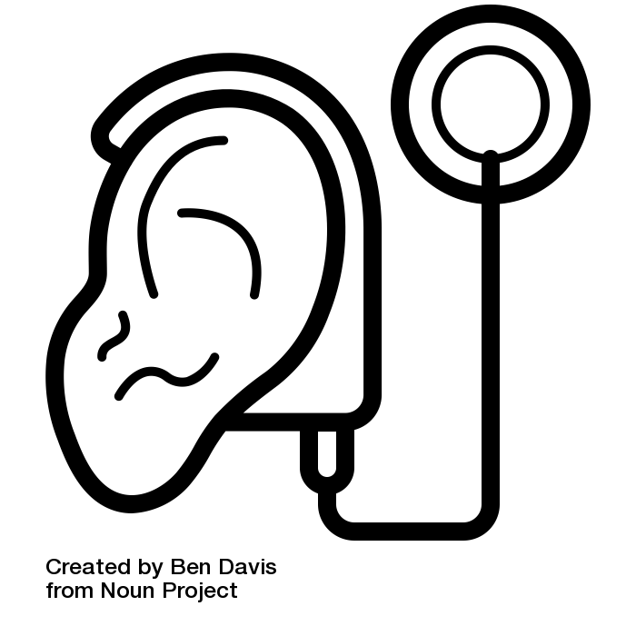


Slide 7
Objectives
Develop an interpreter, utilising deep learning models, capable of interpreting ASL in video format and output interpretations in near real-time
Provide groundwork which future parties can build upon
To improve ease of communication between American Sign Language (ASL) users and non-ASL users.

Slide 8
Product Showcase

Slide 9
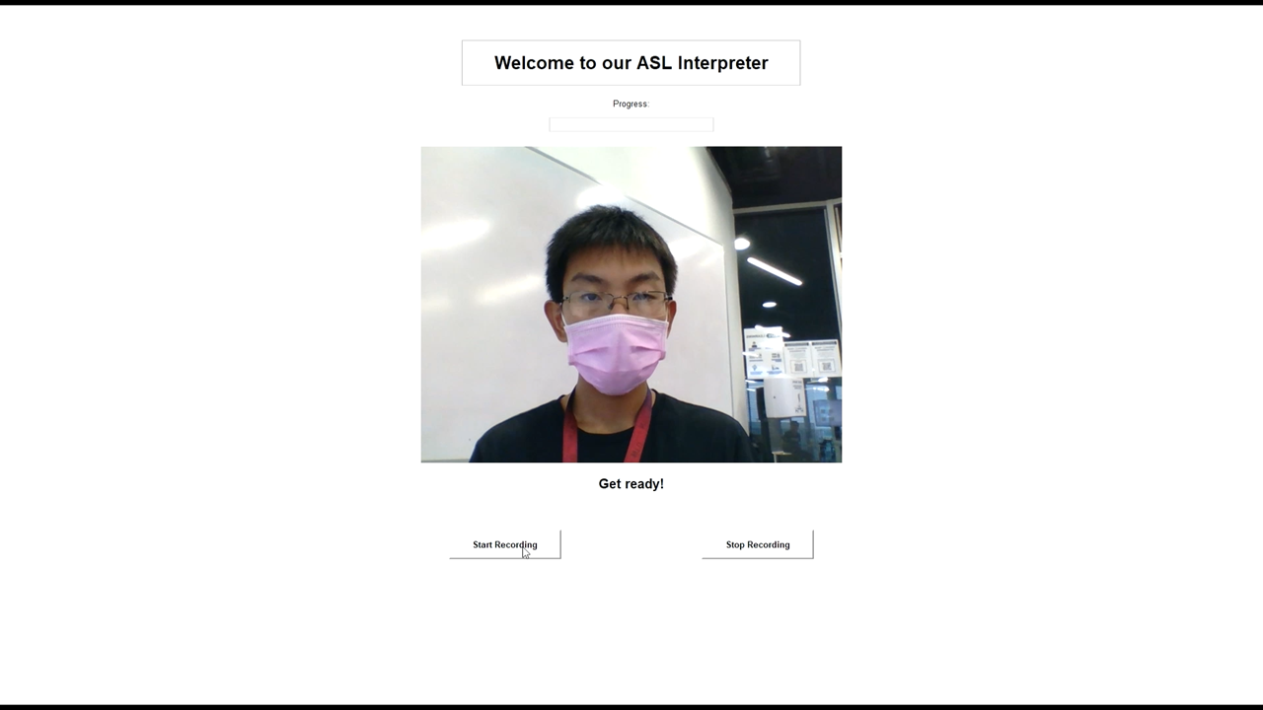

Slide 10
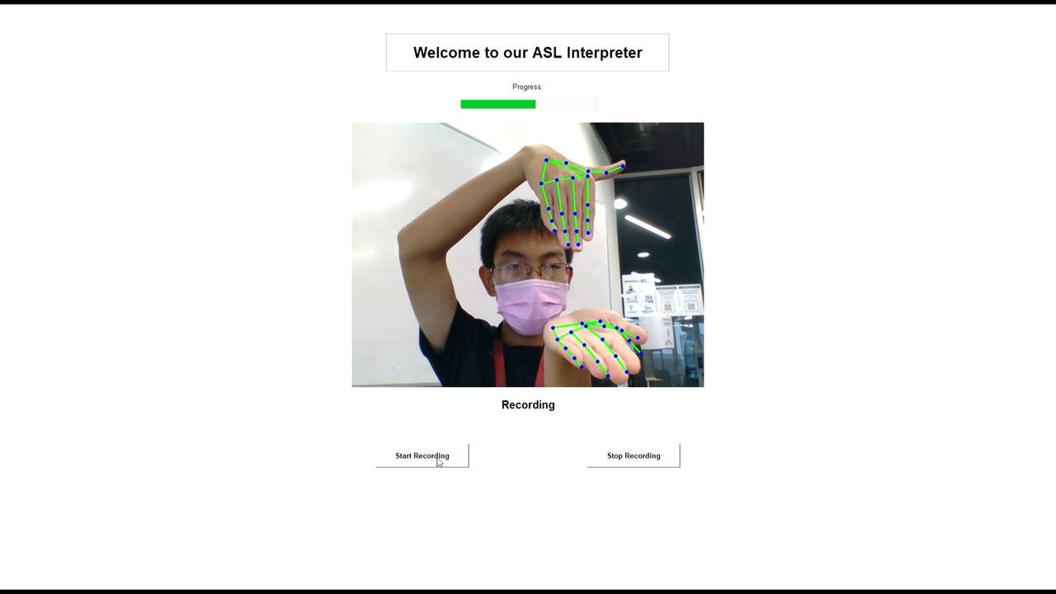

Slide 11
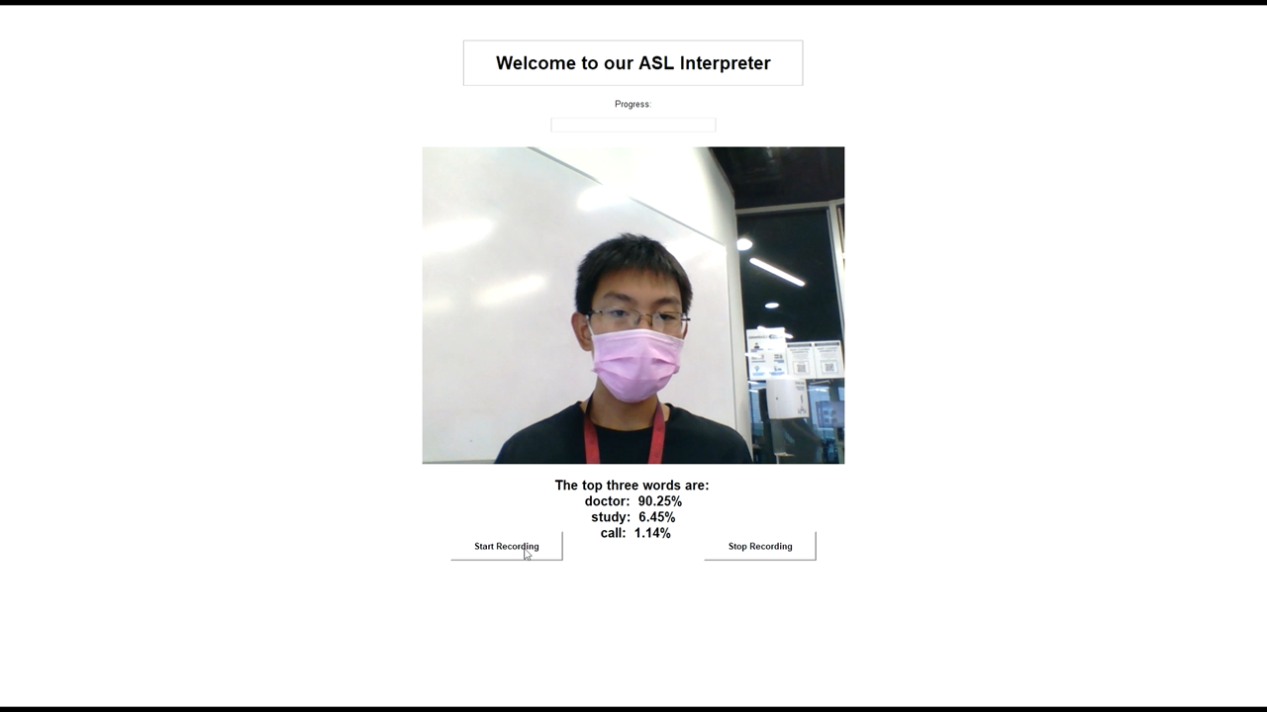

Slide 12
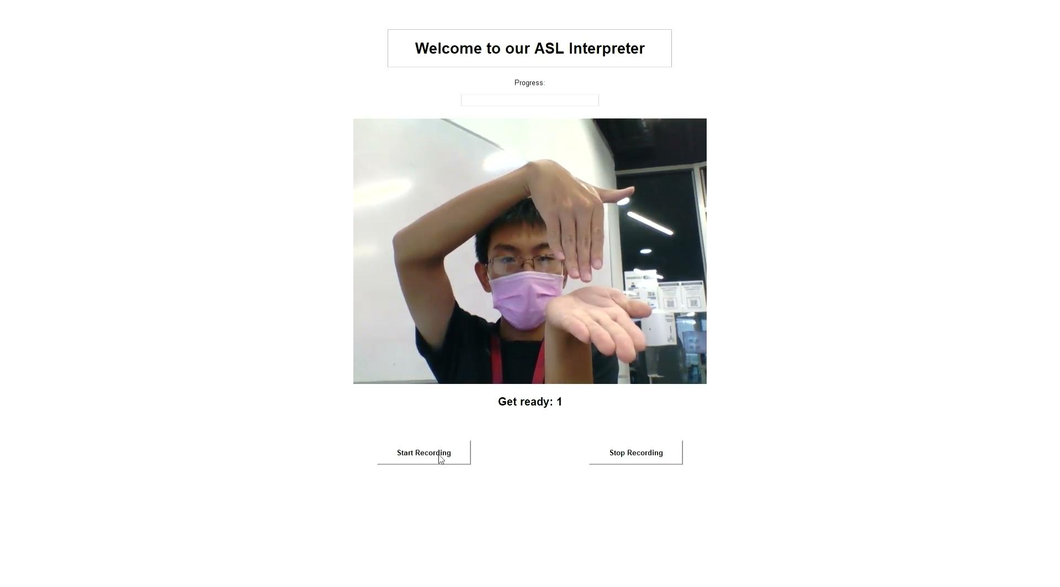

Slide 13
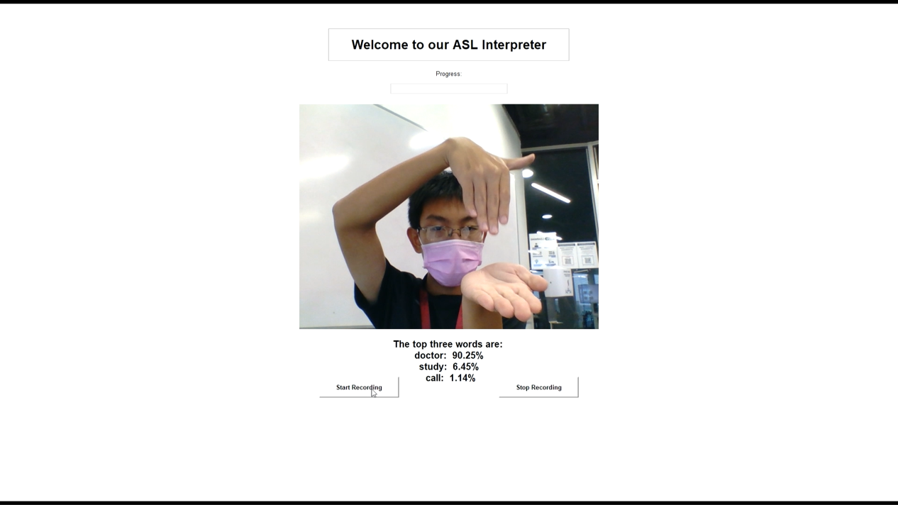

Slide 14
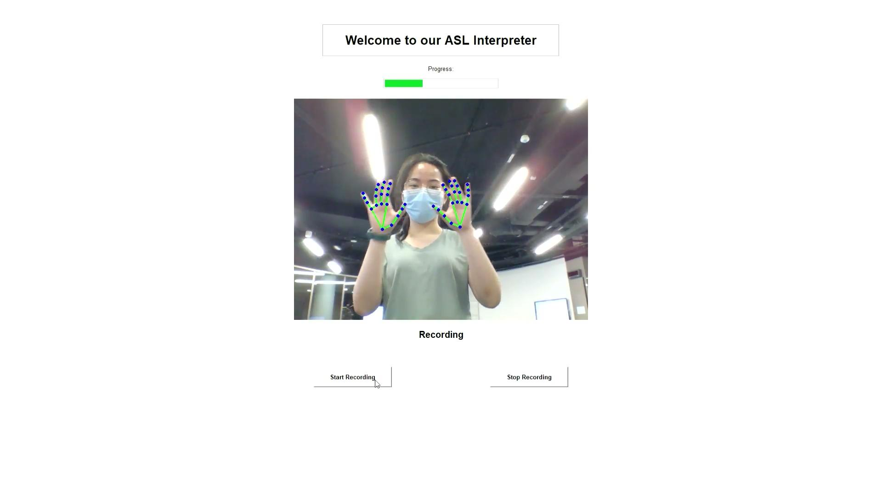

Slide 15
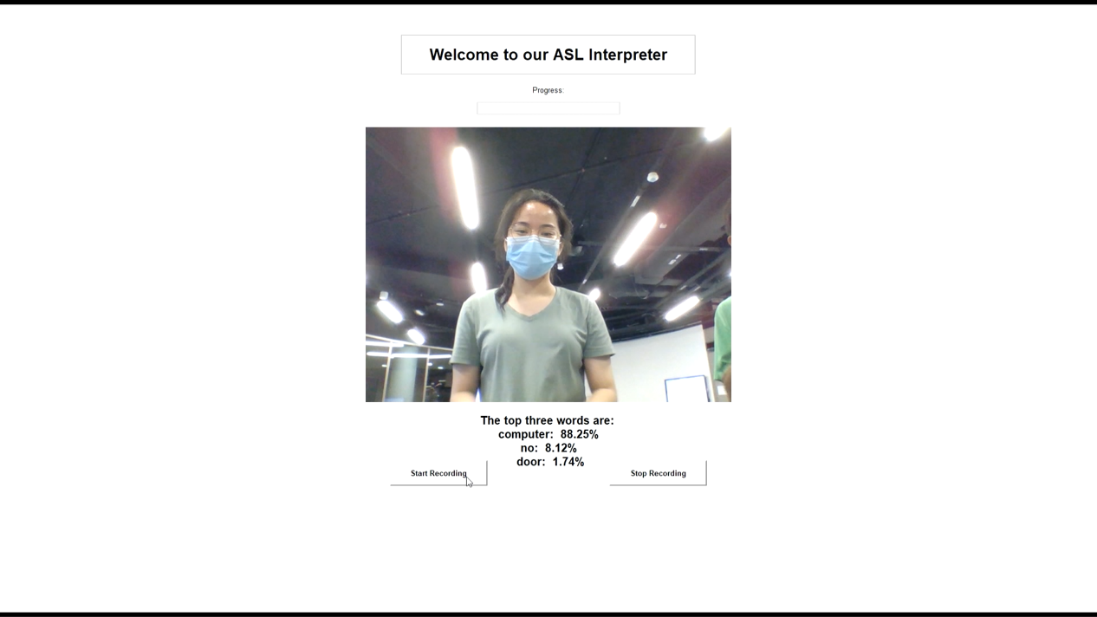

Slide 16
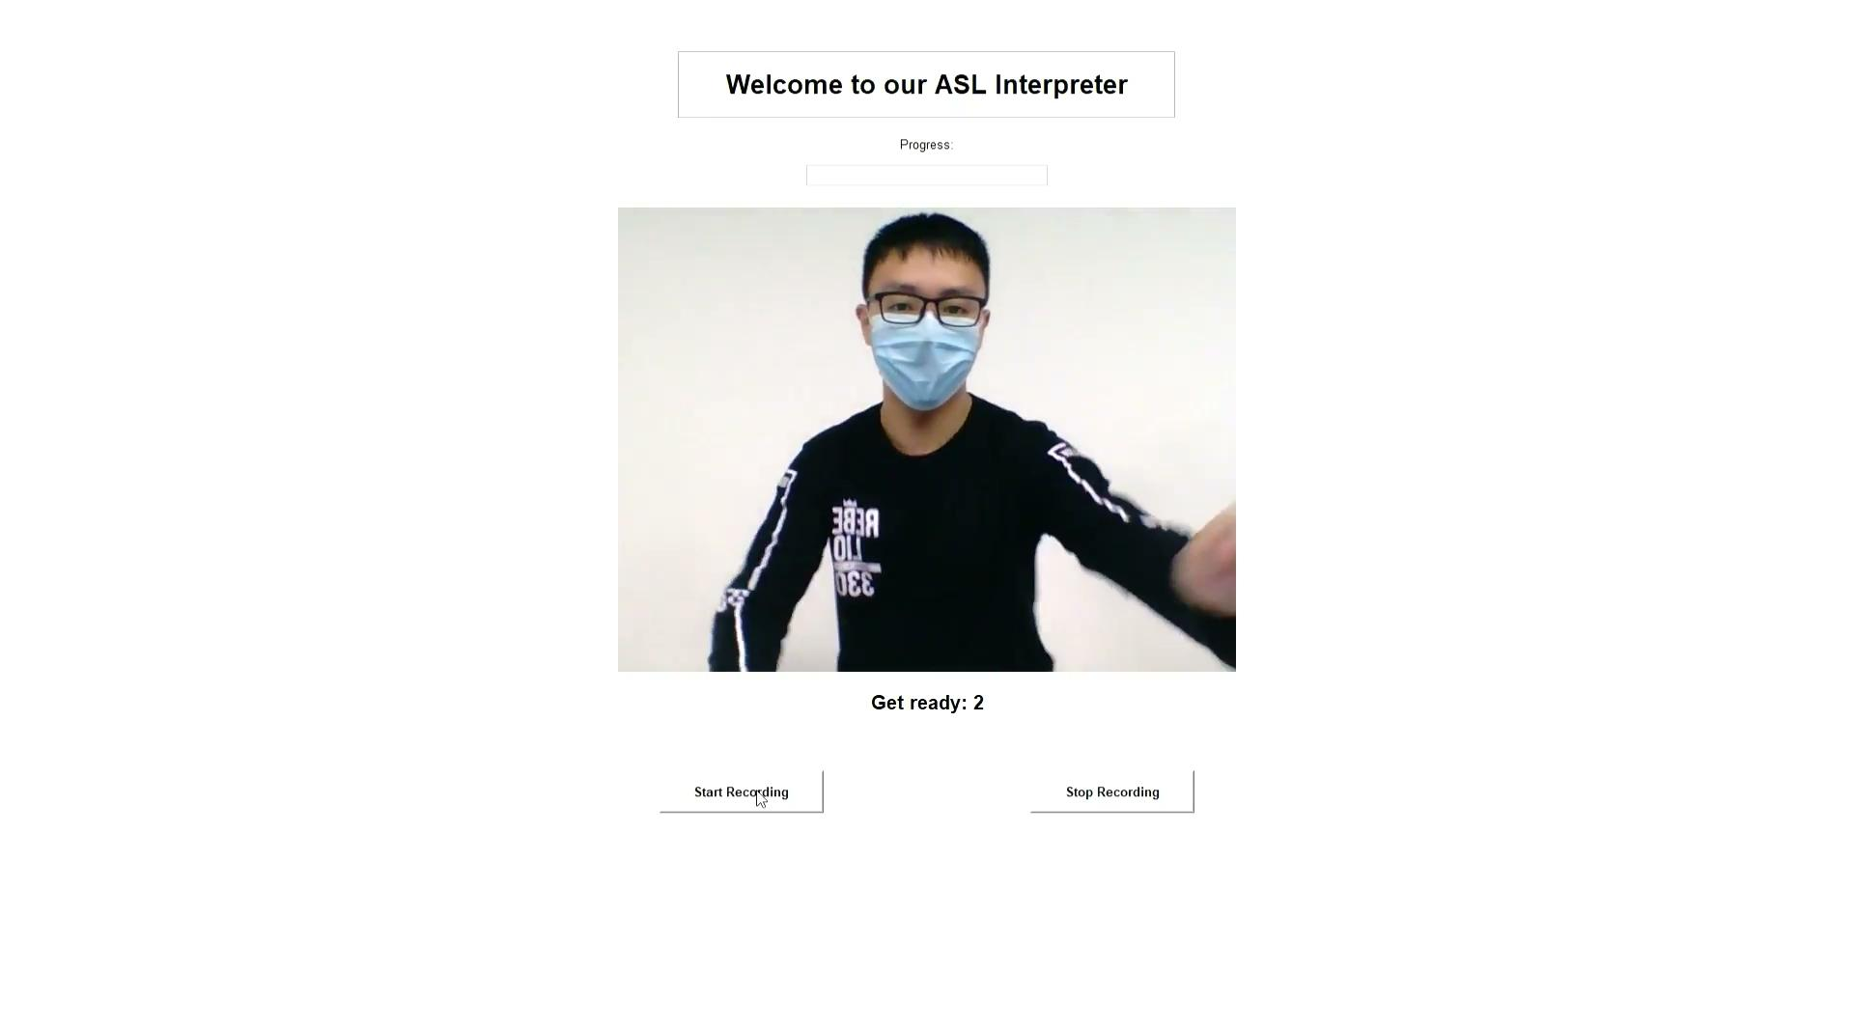

Slide 17
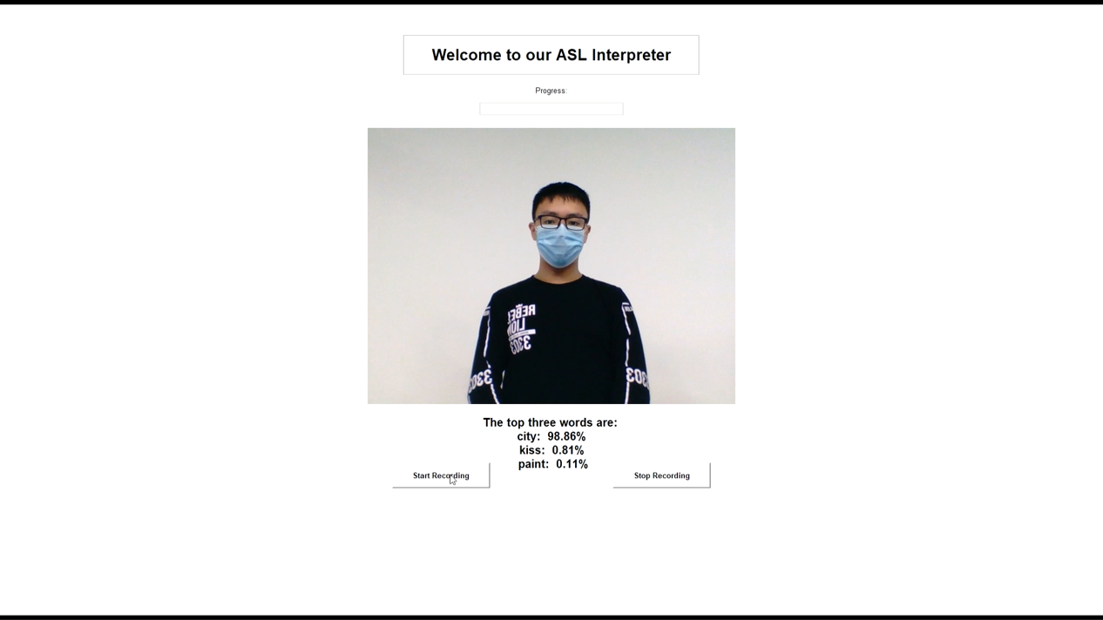

Slide 18
Merits & Limitations

Slide 19
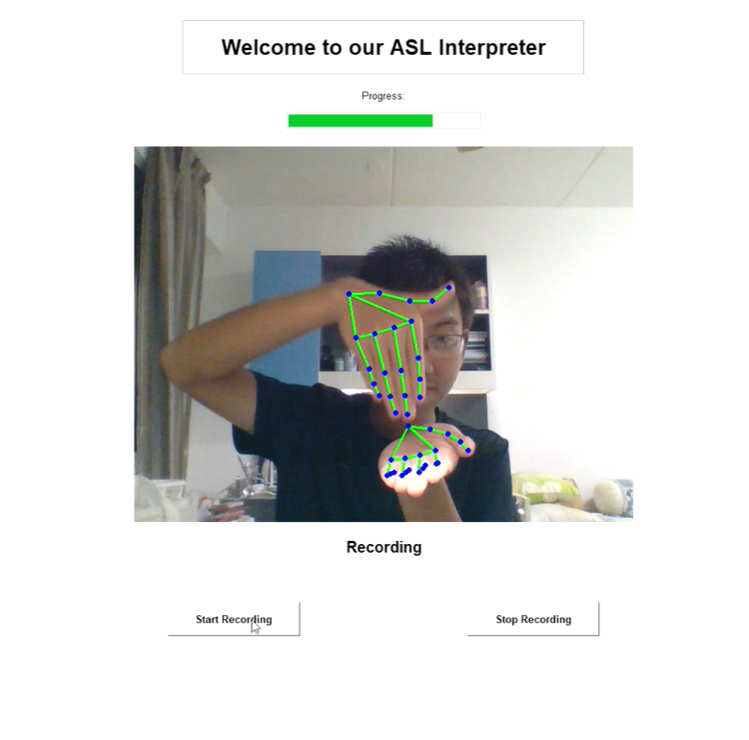
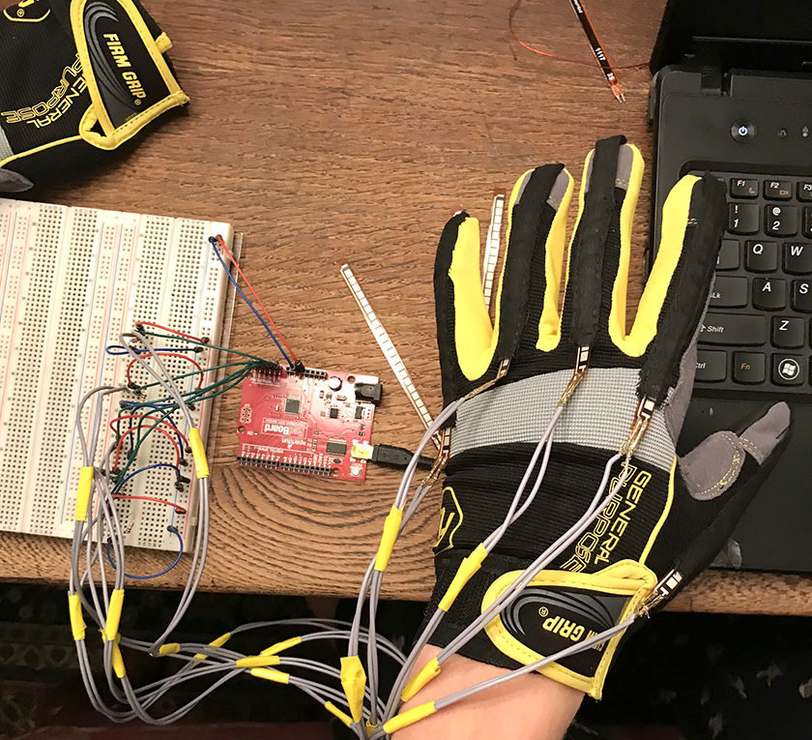
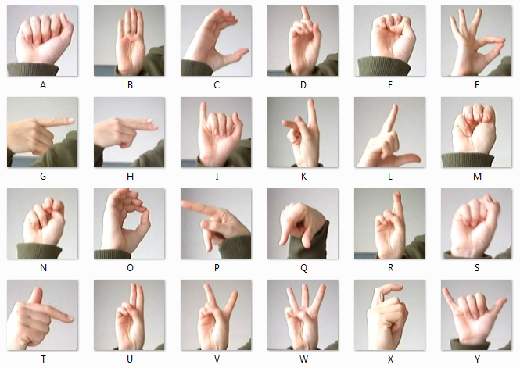
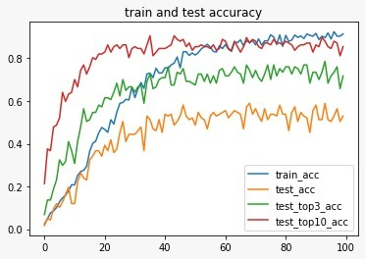
Merits
Expand the capacity of interpretation to 111 words
Accuracy
Train accuracy: 91.43%
Test accuracy: 52.99%
Top 3 accuracy: 71.79%
Top 10 accuracy: 85.47%
Our model is user friendly and cost saving
111 Words
[4,5]

Slide 20
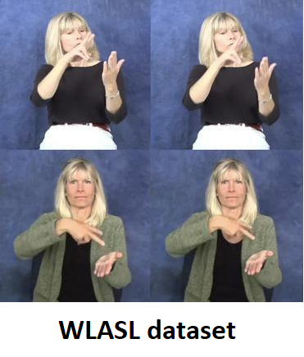

Limitations
Limited source of dataset
Performance of data extraction
111 Words
Limited interpretation capacities
53%
Test accuracy
[6]

Slide 21
Approaches & Outcomes

Slide 22
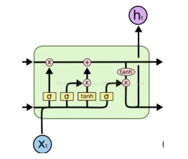
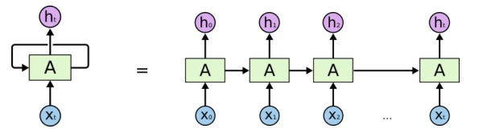
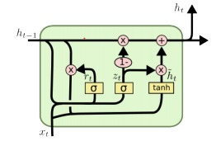
Types of Deep Learning Model
Recurrent Neural Network (RNN)
process different lengths of input sequences
Long short-term memory networks (LSTM)
Addresses the vanishing gradient problem
Gated Recurrent Unit (GRU)
Less calculation in each internal cell
Notes:
We are essentially solving a classification problem on a set of time series data and recurrent neural network is the most prevalently used deep learning model for this type of problem.
Simple RNN uses simple internal states to process different lengths of input sequences, there are two modified versions of RNN, called…, they are similar in performance and both addresses the problem of vanishing gradient which a simple RNN faces.
We chose GRU as the model for trial in early stages because it trains faster than LSTM

Slide 23
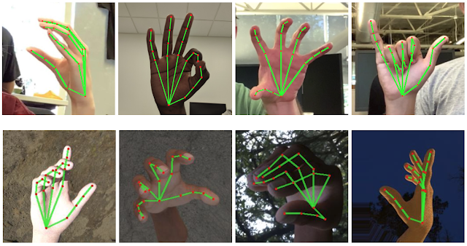
Hand gesture feature extraction
[n, 2, 21, 3]
Using mediapipe.solution.hands
[7]
Notes:
Now we prepare the data for model training. Using pre-trained mediapipe model, we can extract the hand features in each frame of the video and store in as a 4D array.
We then randomly partition the dataset into train, development and test set.

Slide 24

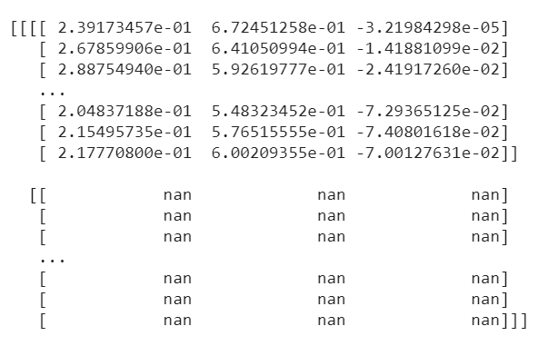
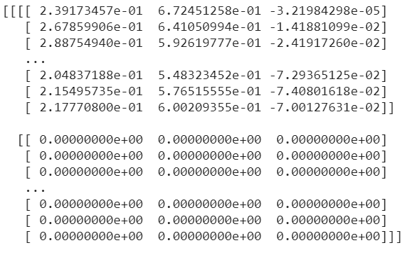
Data Preparation
Accuray: 3 %
Notes:
Next we replace the NaN values in the 4D array with zeros, but cause NaN means not a number and cannot be used by the model in prediction calculation. After this step of data cleaning, we obtained a prediction accuracy of 3%, which was far from satisfactory. How do we improve from here?

Slide 25
Mitigate Bias in Dataset
 | Accuracy
Train Set | 97.46%
Dev Set | 16.23%
Dev Top 3 | 34.34%
Dev Top 10 | 61.89%
Remove less-represented words
Filter out zero frames
Random selection of 16 non-zero frames
Save the dataset [16, 2, 21, 3] for each video
111 words
Notes:
We decided to go back to the dataset, and remove less-represented words. Some words only have 1 corresponding video for the model to learn, while some others have more than 20-30 videos
The model is unable to learn much about less-represented words and hence cannot predict them accurately.
1970 words -- 111 words, each with at least 16 corresponding videos
Random select 16 frames non-0, to reduce frame repetition and accelerate training speed
Store the data [16, 2 ,21, 3]
Accuracy:
Can we do better?

Slide 26

Mitigate Bias ctnd
[16, 2, 21, 3]
 | Accuracy
Train Set | 97.46%
Dev Set | 16.23%
Dev Top 3 | 34.34%
Dev Top 10 | 61.89%
 | Accuracy
Train Set | 91.33%
Dev Set | 29.06%
Dev Top 3 | 48.30%
Dev Top 10 | 73.96%
Notes:
Problem: fix set of 16 frames, some frames are not utillized to train
Solution: random selection at beginning of each epoch, diff set of frames used
Accuracy:

Slide 27
Hyperparameters
Dataset
Seq_len
Hidden_size
Num_layers
Bi-directional
Batch_size
Learning_rate
Type of RNN model
Model complexity
Training Process
Notes:
Here are the hyperparameters involved in our model.
/*
The first hyperparameter controls the amount of information fed into the neural network. Because sequence length determines the number of frames selected for each model.
The next three hyperparameters, …, adjusts the complexity of the neural network
Batch_size and learning_rate regulates learning process
*/

Slide 28
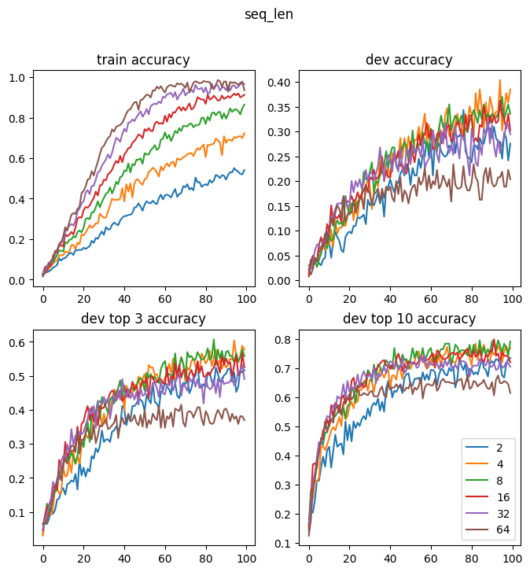
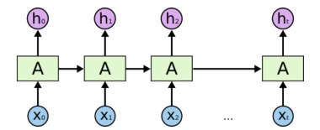
Hyperparameters on Dataset
Seq_Len
No. of Frames from each video
= 8
Notes:
If seq_len is too small, there would not be enough information for the model to learn.
if the sequence is too long, there may be too many similar frames, and the model may forget the information earlier in the sequence.
In the graph, the x-axis is the number of epochs, the y-axis is accuracy.
According to the above comparison, 8 frames per video, the green line, gave the best performance, thus it was chosen.

Slide 29
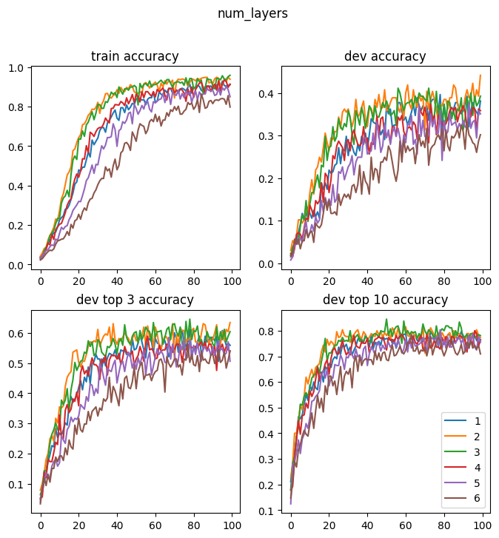
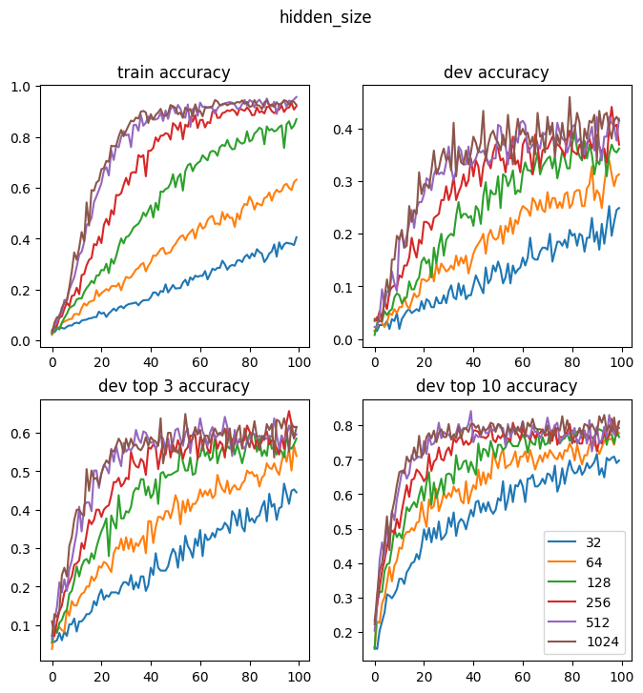
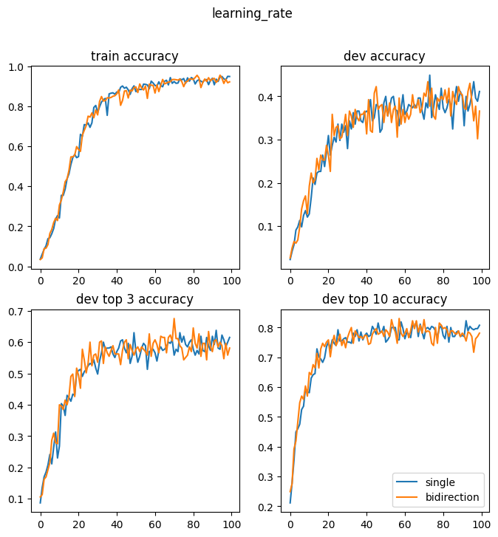
Hyperparameters for Model Complexity
= 512
Hidden_size
Num_layers
Bi-directional
= 2
= False
Notes:
Here are the hyperparameters of the GRU model.
They will adjust the complexity of the model.
Since the model was to make predictions among 111 words, a relatively larger hidden size was preferred. According to the graph, we decided to use hidden size of 512.
A GRU model that had too many layers would be too complex and would have a higher chance of overfitting on the train dataset. According to the graph, we chose num_layers = 2.
We also tried Bi-model, but it did not improve the accuracy. This is probably because our data was a time series and should not be interpreted in the reverse order. Thus we decided to use a single direction model.

Slide 30
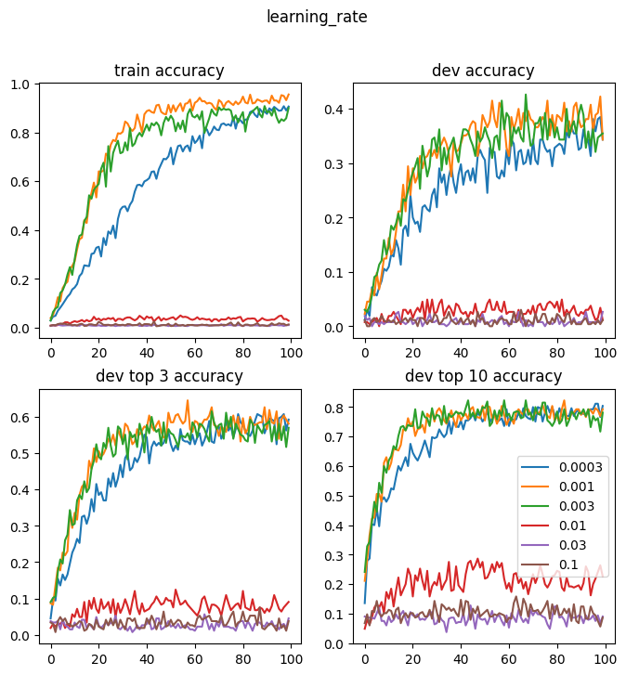
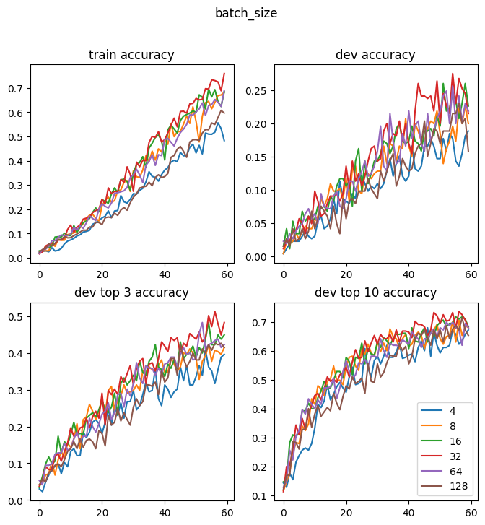
Hyperparameters for Training Process
= 32
Batch Size
Learning Rate
= 0.001
Notes:
Here are the hyperparameters for training process.
By experiments, an appropriate batch size of 32, and learning rate of 0.001 were used for better performance.
/*
In order to fully utilize the power of GPU to accelerate the learning process, we should not use a very small batch size. We chose to use 32 as batch size.
If the learning rate is too small, the loss would not improve much over many epochs and might get stuck in the local minima. If the learning rate is too large, the loss might overstep the global minimum.
Hence, the appropriate learning rate must be selected and we eventually used a learning rate of 0.001.
*/

Slide 31
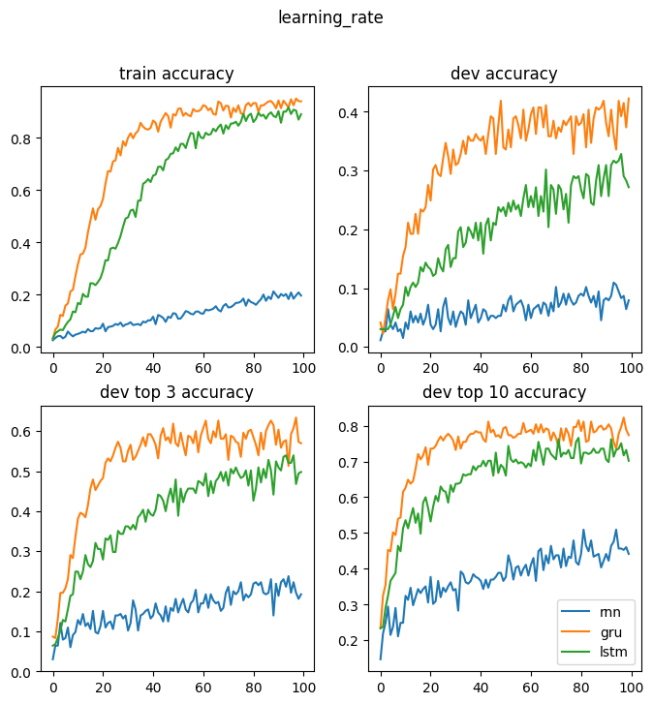
Hyperparameters:
Type of RNN Model
Simple RNN
GRU
LSTM
VALIDATED
Fastest Training
Best Performance
Notes:
Among three different RNN models, our choice of GRU has been validated here. As it trained fastest and gave the best performance.

Slide 32
Problem of Overfitting
Small Dataset
Complex Model
Notes:
Because our dataset was small and the model was quite complex, we faced the problem of overfitting.

Slide 33
Deal With Overfitting
Regularization:
Add additional penalty to the loss
Use of Dropout
Data Augmentation:
Modify the data slightly -> increase the size of dataset
FAILED
Notes:
/*
What is overfitting? The model corresponds too close to the train dataset and fail to generalize on future dataset.
Signs of overfitting? The train accuracy is increasing while the accuracy on dev set is non-increasing.
*/
In order to deal it, we tried two methods.
One was regularization: we added additional penalty to the loss so the parameters would not be too large, and used dropout /*so some parameters would not be updated during the back propagation.*/ However, these methods failed to improve our model.
Another method was Data Augmentation, which is modifying the data slightly to increase the size of dataset.

Slide 34
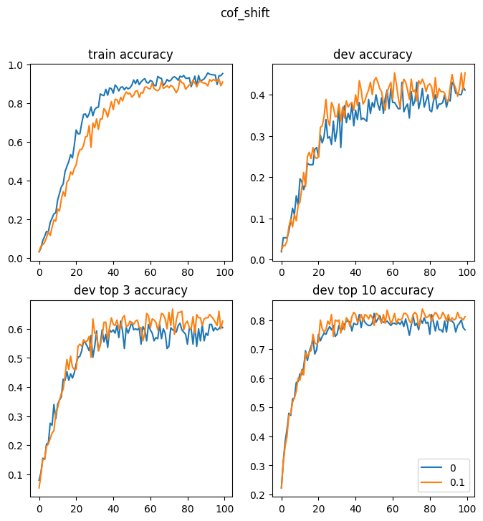
Data Augmentation
SUCCESSFUL
Random selection of Frames
Add a random shift to x and y
Mirror the videos
Notes:
We use three methods for Data Augmentation
As mentioned earlier by Xinhui, we applied random selection of frames at the start of each epoch, and it has been proven to be effective.
Second, As a uniform shift of hand gesture would not change its meaning, we added a shift to x and y when the array was loaded. By experiments, a uniform shift with a random value between -0.1 to +0.1 can improve the dev accuracy.
We also tried to mirror the videos, but this showed no improvements.

Slide 35
Results
Test acc: 52.99%
GRU Model
Feature Extraction &
Data Preparation
Hyperparameters Adjustment
Top 3 word accuracy: 71.79%
Top 10 word accuracy: 85.47%
Data Augmentation
Notes:
After we adjusted our model and data according to these four steps, we eventually achieved test accuracy of 52.99%.

Slide 36
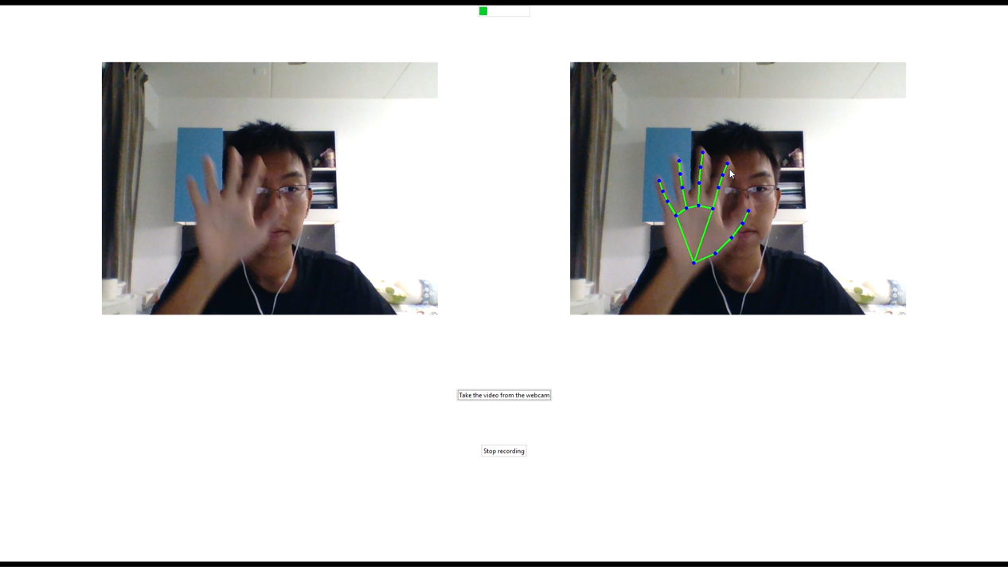
Application Development [Iteration 1]

Slide 37
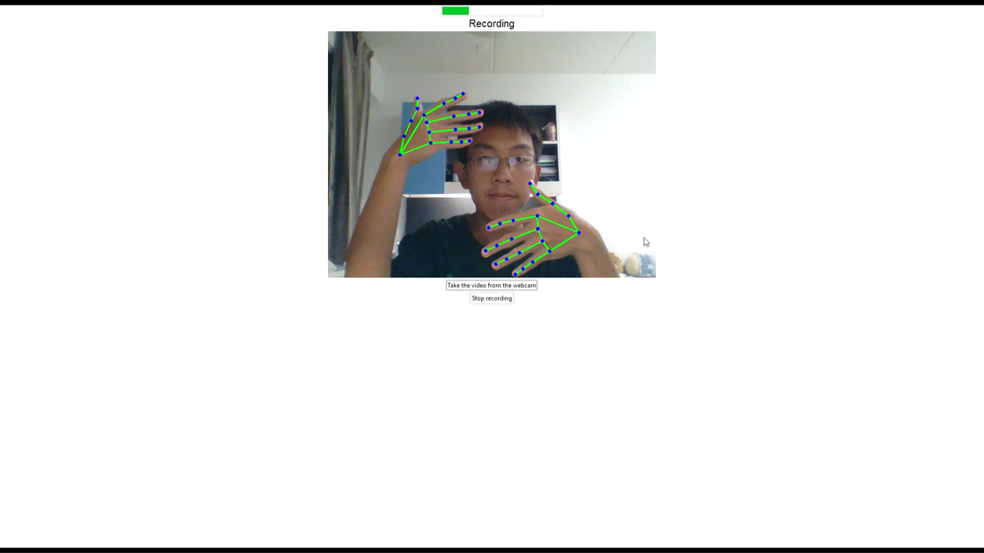
Application Development [Iteration 2]

Slide 38
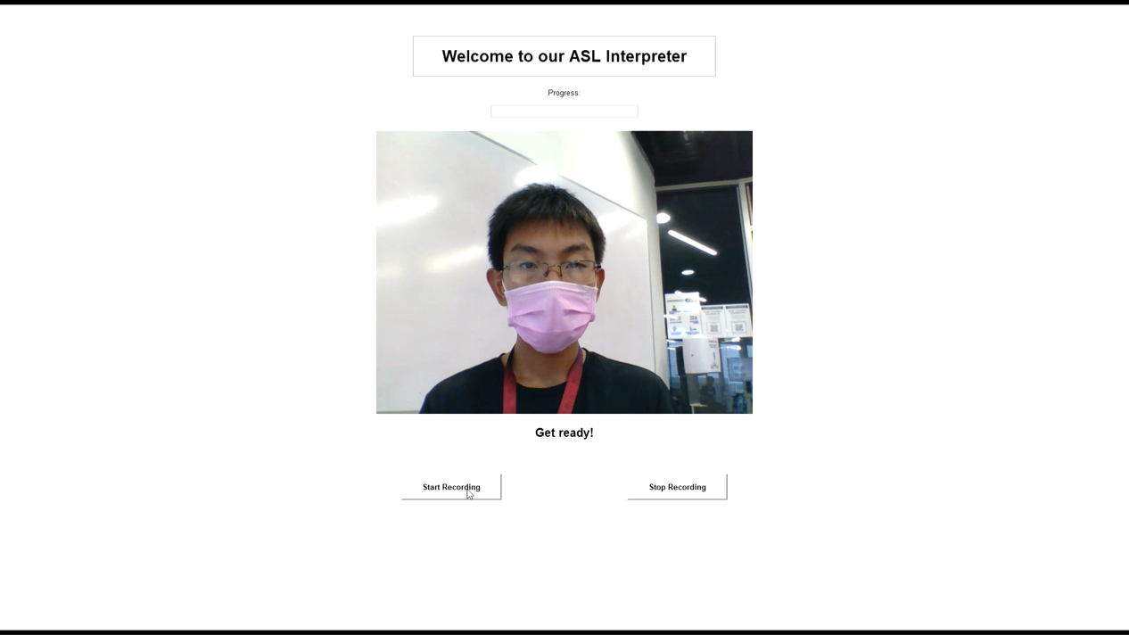
Application Development [Iteration 3]

Slide 39
Future Improvements

Slide 40
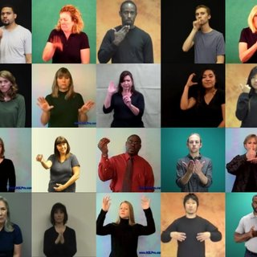
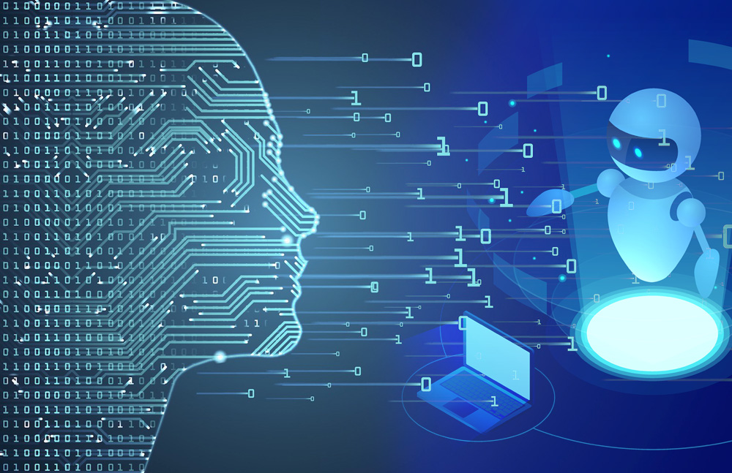
Improve on Current Shortcomings
Expand capability: interpret more words
Expand database
Notes:
We can make improvements targeting on the shortcomings of the existing model.
For instance, at the moment our sign language recorded videos are only sourced from the WLASL database. If time and resources are permissible, we can source more videos from multiple database, so as to expand the quantity and variety of our overall database.
With a larger database, it is possible that we can have a less biased data, thereby allowing for extending the interpretation capabilities to be able to interpret more ASL words.

Slide 41
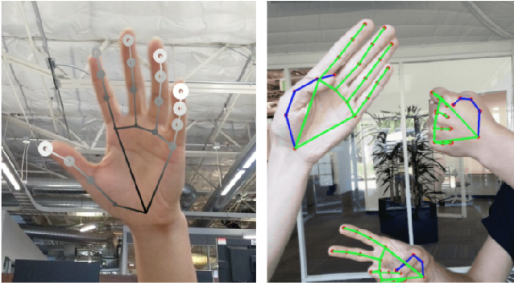

Improve on Current Shortcomings
Improve Prediction Accuracy
Improve API on feature extraction
Notes:
Also, perhaps in a few more years of time, there will be better performing APIs that can perform the function of hand landmark feature extraction. This could provide a more reliable tool for generating more accurate NumPy arrays for our model training purposes.
Throughout our project, we realised that model accuracy is very much reliant on the quality and quantity of database. Perhaps with the database improvements as mentioned above, it is possible for the model to enhance the accuracy.

Slide 42
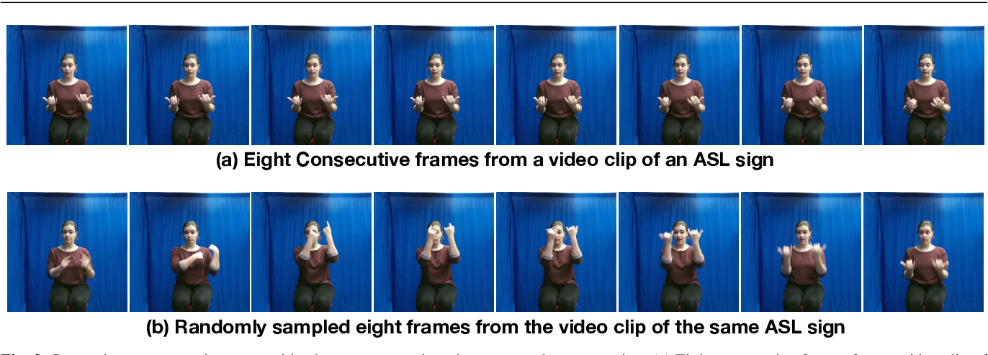
Consecutive Gesture Interpretation
Expand Application Capability: interpret consecutive gestures as complete ASL sentence
Notes:
Currently our model is only capable of interpreting individual sign language gesture at each video-taking, each time generating only 1 interpreted English word output.
This model could be useful for individual learning and training purposes, but would be less useful in real-life application, as most of the real-life scenarios would involve sign language conversations in complete sentences, in other words, consecutive performance of sign language gestures.
Therefore, future improvements can focus on extending the capability of the computer application to be able to interpret consecutive hand gestures and form an array of English words output.

Slide 43
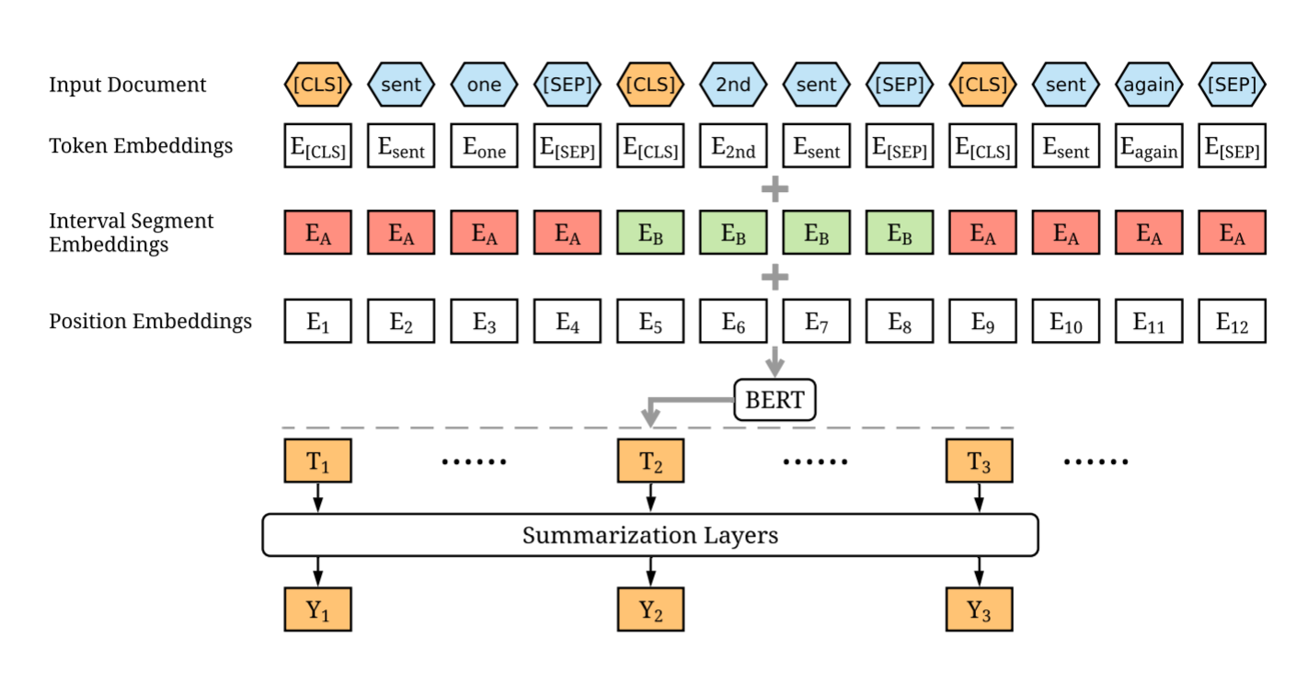
Applicability with Natural Language Processing (NLP)
Apply NLP to convert discrete words into coherent and meaningful English sentences
Notes:
Imagine the situation when our model is capable of interpreting consecutive sign language gestures, as mentioned above. Our final step of improvement could focus on converting the English word array into a meaningful English sentence using NLP techniques.

Slide 44
Concluding Statements

Slide 45
Achievements
Identified the realistic need from the Deaf community to develop a sign-language interpretation model
Trained a deep neural network model
Improved interpretation accuracy from 3% to 53% with data preprocessing and hyperparameter adjusting
Designed and developed an application with proper user interface
Model expands interpretation capabilities to 111 words

Slide 46
Key Takeaways
Gained an appreciation of the need for data preparation, manipulation and augmentation and their decisive impact on the performance / final accuracy of our model
Developed thought processes and data science skillsets to identify gaps in our model and tune hyperparameters to adjust and improve it

Slide 47
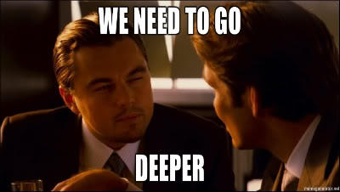
Key Takeaways
Gained a deeper understanding of deep learning models through this EE8101 Exploring DEEP in Innovation Course
Market Evaluation of our Product: USD 50 Million
Developed friendships~

Slide 48
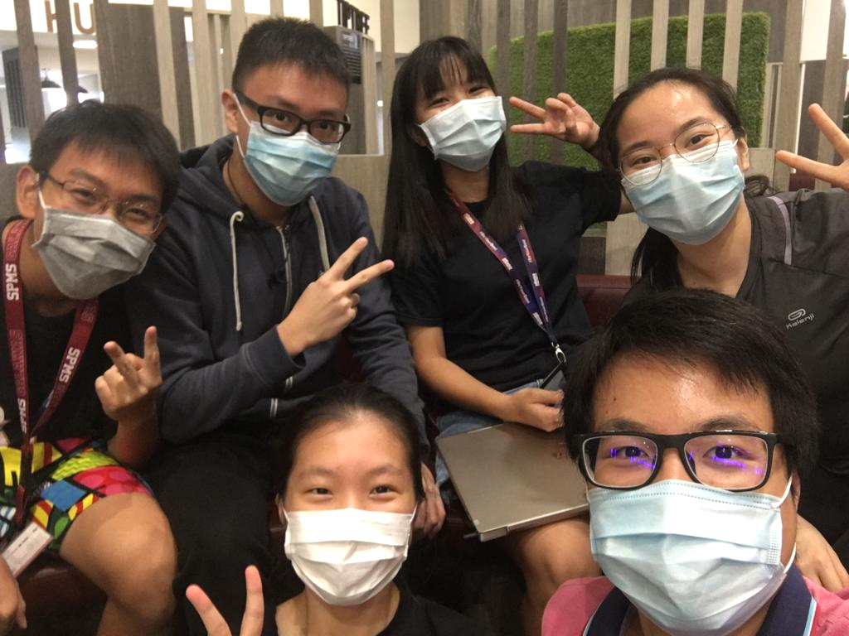
Thank you for your attention.

Slide 49
References
[1] World Health Organisation, “Deafness and hearing loss,” 1 March 2020. [Online]. Available: https://www.who.int/news-room/fact-sheets/detail/deafness-and-hearing-loss [Accessed 6 January 2021].
[2] National Institute on Deafness and Other Communication Disorders, “What is American Sign Language (ASL) | NIDCD,” National Institute on Deafness and Other Communication Disorders, March 2019. [Online]. Available: https://www.nidcd.nih.gov/health/american-sign-language. [Accessed 9 January 2021].
[3] J. E. Nash and A. Nash, Deafness in society, Massachusetts: Lexington Books, 1981.

Slide 50
References
[4] T. Sang, “Vietnam Sign Language Recognition using Hand MediaPipe framework and LSTM model,” Ho Chi Minh University of Technology, 9 March 2021. [Online]. Available: https://github.com/thanhsang298/Viet-Nam-Sign-Language-Recognition-using-Hand-MediaPipe-framework-and-LSTM-model. [Accessed 8 April 2021].
[5] S. A. Mehdi and Y. N. Khan, “Sign language recognition using sensor gloves,” Proceedings of the 9th International Conference on Neural Information Processing, no. ICONIP'02, 2002.
[6] D. Li and H. Li, “Welcome to WLASL Homepage | WLASL,” GitHub, Inc., 20 Jan 2020. [Online]. Available: https://dxli94.github.io/WLASL/. [Accessed 9 January 2021].

Slide 51
References
[7] Google LLC, “Hands - mediapipe,” Google LLC, 2020. [Online]. Available: https://google.github.io/mediapipe/solutions/hands. [Accessed 9 January 2021].

Slide 52
Q&A

